Slide 1
Harmonization of gas quality update
UTIL-GQ-11-10 / D113
Meeting with ACER 12th October 2011
Daniel Hec

Slide 2
Brief history of the project
1999-2001: EC identifies interoperability issues including
  Gas quality specification
  Odorisation practices
2002-2005: EASEE-gas prepares CBP Gas quality
  Pipeline parameters
  defined, implementation
  date 2006
  Combustion
  parameters proposal
  by MARCOGAZ

Slide 3
Proposal not accepted
Proposal raises criticisms:
  Safety issues (especially for domestic)
  Strong impact on efficiency, environment (emissions)
Need to investigate to validate harmonization of combustion parameter
EC launched mandate M/400 to CEN (16/01/07)
  Phase 1 study of appliances (CEN BT WG 197)
  Phase 2 testing presentation of a EN Standard
In parallel cost/benefit analysis to evaluate how harmonization should be implemented (GL/Pöyry)

Slide 4
Phase 1: Appliance behaviour study
Objectives:
  Present a panorama of EU GAD certified appliances market, certification and installation rules and practices
  Evaluate impact of gas quality variation on safe operation, efficiency & environment emissions of GAD appliances
Pre-standardization work managed by CEN/BT WG197 (AFNOR secretariat)
  Market study & testing subcontracted to GASQUAL Consortium (DGC – Denmark)
    16 Companies/Organisations around EU (from 9 Countries)
    5 laboratories involved
    2.9 M€ work
  Total budget 3.5 M€
Contract Commission/CEN signed 18th December 2008
Work started 1st January 2009
Notes:
This slides, already presented last May, just reminds the objectives of phase 1 (…) the way CEN is working (subcontracting to a consortium of 16 EU companies. Total action cost is about 3.5 M€) The work actually started in January 2009. We are now at mid-term (an interim report as been presented for evaluation to the commission).

Slide 5
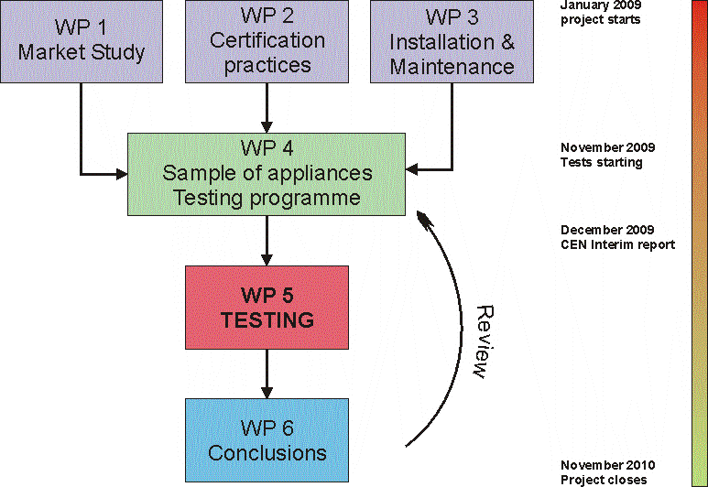
Organisation and timeline
Work programme delayed by one year (December 2011)
Notes:
The study is structured around 6 work packages. The first 3 ones are nearly completed as the deliverables have been presented to WG 197 and we are just discussing some details, but basically the work is completed. From the results of these first 3 deliverables WG 197 expected a testing programme and a sample of appliances to test for a final validation.
However the situation is very complex.
Lot of different appliances and technology from which we must select the most representative.
Lot of conditions are relevant for testing means lenghthy and costly testing.
As we have to find an adequate balance to guarantee that the sample of appliances tested as enough representativity and that the testing programme is meaningful we had to change the procedure.
Testing has started with a minimum list of appliances and a quite extensive testing programme. It is expected that according to the incoming results GASQUAL will propose new appliances to include in the testing and simplification of the testing programme. This process asks for CEN WG 197 to be closely involved for validating all proposals.

Slide 6
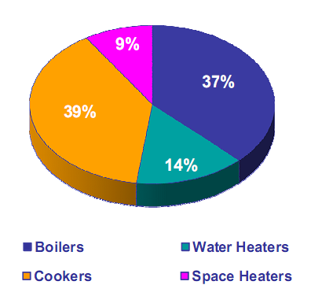


Some results
Total population of domestic appliances in 16 selected EU countries:
178 327 000
About 10-20 millions non domestic
  Decentralised air heaters
  Catering equipment
  Boilers and others
Certification practices homogeneous
Main issue: On site "adjustment"
  Burner pressure adjustment
  Air:gas ratio adjustment
Testing programme has to assess effect of "adjustment"
Notes:
As for the results of WP 1 2 & 3, the main data are as shown.
From WP 1 we have a good knowledge of the appliances situation in the 16 EU countries considered (covering 91% of the appliance market). Roughly 200 M appliances…
The knowledge about non domestic appliances is much more sketchy. Furthermore, if some results from testing domestic appliances can be implemented to evaluate the non domestic market (for instance some results with domestic boilers may be relevant for some non domestic ones with similar technologies) infra red heaters and lot of catering equipment are using very specific technology Thus the impact of changing gas quality on those type of appliances may be difficult to obtain.
From WP 2 a green signal has come back about certification practices.
WP3 raises the major concern as a number of on site adjustment procedure as been identified that can lead in a modification in the behaviour of the appliance when fed with changing gas quality when compaired with the behaviour observed under certification. It is very important that the testing programmes allows for simulating these adjustment to assess their real effect.

Slide 7
Current status
Final report of CEN/BT WG 197 close to completion
  First draft circulated for comment
  Last meeting schedule 30th November 2011
  Schedule for sending to CEN → EC: 10th December 2011
Issue of adjustment confirmed
  10 million appliances potentially concerned
  To be studied at national level
Non adjustable appliances quite robust to gas quality variations in a wide range
  100 million not affected
  Others affected at different degrees
  Impact related to other influence parameter (pressure, etc).
  Country per Country analysis of results seems necessary
Non domestic appliances
  Manufacturers reluctant to allow wide range

Slide 8
Standardisation activities in progress
Mandate M/400 phase 2
  CEN/TC 234 WG 11 (kick off meeting 15th September 2011)
  target date: 2014
Mandate M/475 Biomethane
  CEN/PC 408
  Biomethane injection in gas grids
  Biomethane used as a fuel for transport
  target date: 2014

Slide 9
Possible outcome
Target for harmonization close to current EASEE-gas proposal (47 MJ/m³-54 MJ/m³)
Recommendations for further actions
  Respect manufacturers maintenance instructions
  Do not allow adjustment on site
  Examine National gas appliances population
  Clarification of performance expectation
  Develop combustion controlled gas appliances
  Envisage Regional gas quality approach
  Decide on Framework Guideline scope
Definition of a roadmap to reach the target

Slide 10
End of presentation
Thank you for your attention!
E-mail to: daniel.hec@marcogaz.org

